Slide 1
Predictive Analysis of Breast Cancer
Induraj PR
https://databricks-prod-cloudfront.cloud.databricks.com/public/4027ec902e239c93eaaa8714f173bcfc/6220173110189044/1607944556757705/2928770111703813/latest.html

Slide 2
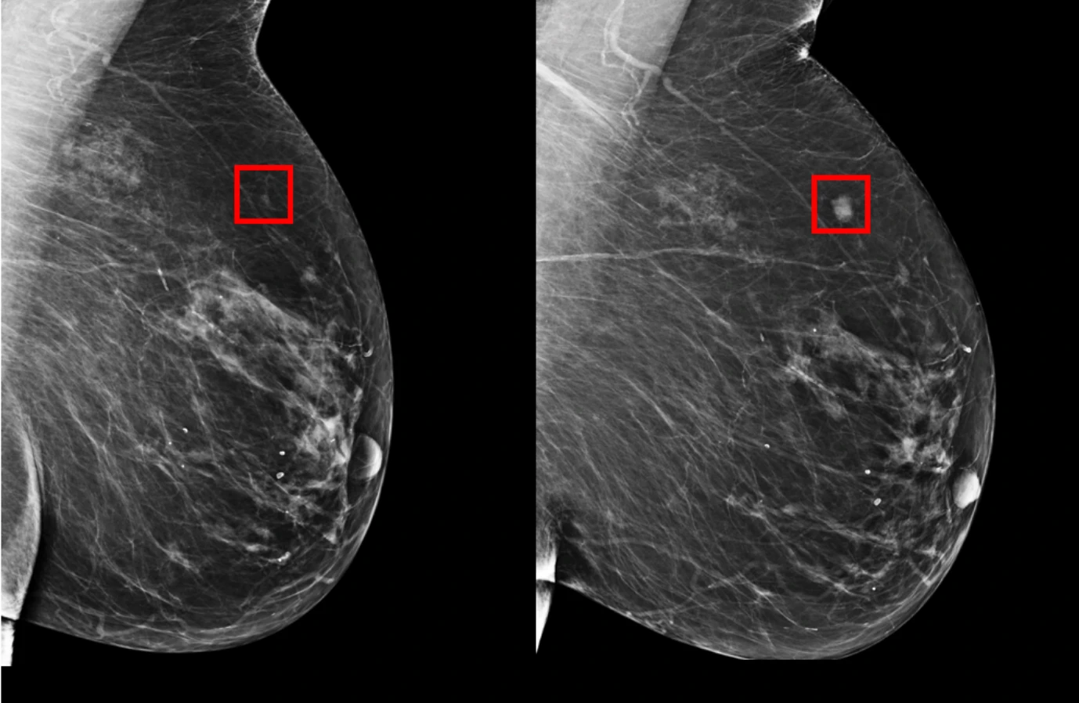
Image Credits: MIT

Slide 3
Breast Cancer- A Serious Threat
One in 30 Womens suffer by Breast Cancer
After skin cancer, breast cancer is the most common cancer diagnosed in women in the United States.
Breast cancer can occur in both men and women, but it's far more common in women.
Diagnosis : MammoGraphy

Slide 4


Big Heads In the field of Predicting Cancer
Kiwi firm Volpara –
Volpara’s analytics software uses Microsoft Power BI to analyze the quality of every mammogram.
IBM AI helps predict breast cancer a year before it appears
–It combines images and medical records to achieve human-like accuracy.
MIT AI Predicts Breast Cancer Risk Up to 5 Years in Advance
MIT CSAIL scientists partnered with Massachusetts General Hospital to develop a deep-learning model that was trained on 90,000 full-resolution mammogram scans from 60,000 patients who were scanned over the course of several years with various outcomes.

Slide 5
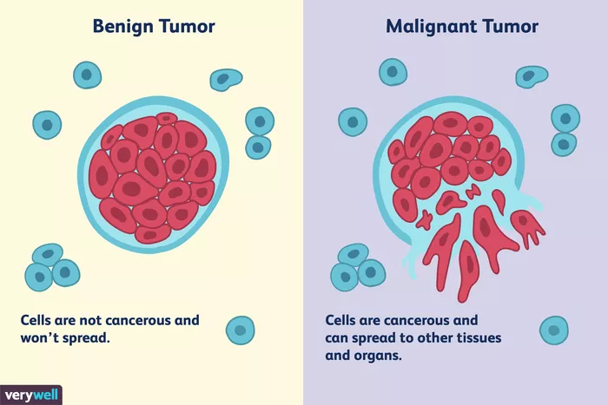
The Bad and the Good
Can be Beningn or Malignant
Beningn (basically doesn’t spread/invade neighboring cell)
Malignant (spreads to nearby Tissues, by entering into Blood Vessels)
Though chemotheraphy, surgical procedures are available, still early detetion of this type of Tumours is a challenge
https://www.verywellhealth.com/what-does-malignant-and-benign-mean-514240

Slide 6
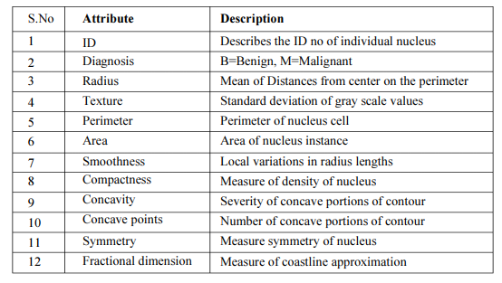
Overview of our Dataset:
Breast Cancer Wisconsin (Diagnostic) Data Set provided by UCI.
32 such attributes.

Slide 7

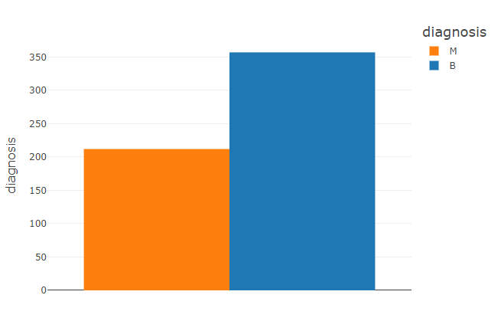
357 benign
212 malignant

Slide 8
EDA
Dataset
Analysis
Visualization
Many visualization plots just to ensure neither irrelevant features gets into model nor the useful feature gets omitted
Violin
Join
Swarm
Heat map
Feature extraction
classification
Comparison

Slide 9
Checking if variable is important
VIOLIN PLOT
From Texture mean, we can find median of M and B are separated, meaning that they are good for classification
Fractal dimensional mean on other hand has M and B’s median matching, so it gives question of should they be ignored
Concavity worse and concave worst point are similar, so are they correlated?
So violin plot though gives a little intuition about variable significance, but still leaves with a bit of confusion, so we check the Join plot

Slide 10
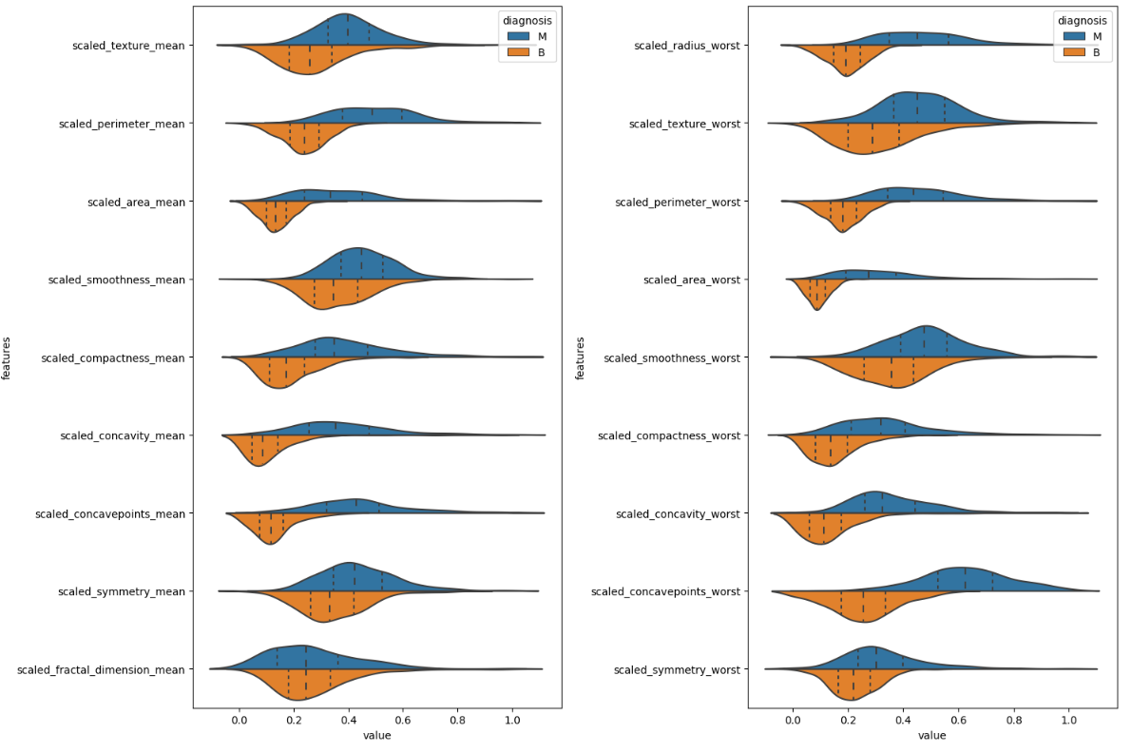

Slide 11
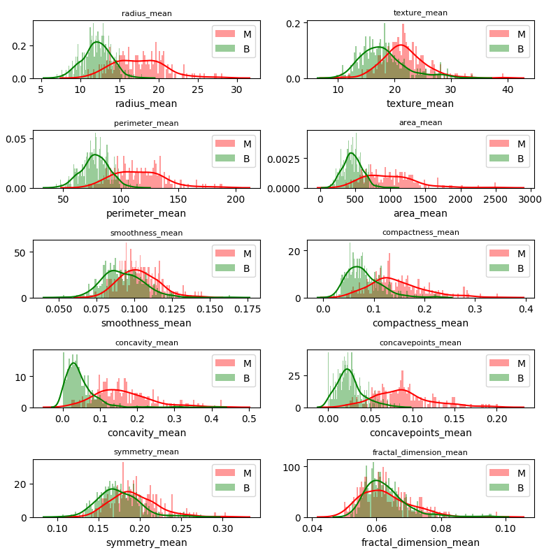
Join plot
Clearly Concavity mean and concave point are strongly correlated
So one of this is removed (the one with less significance)

Slide 12
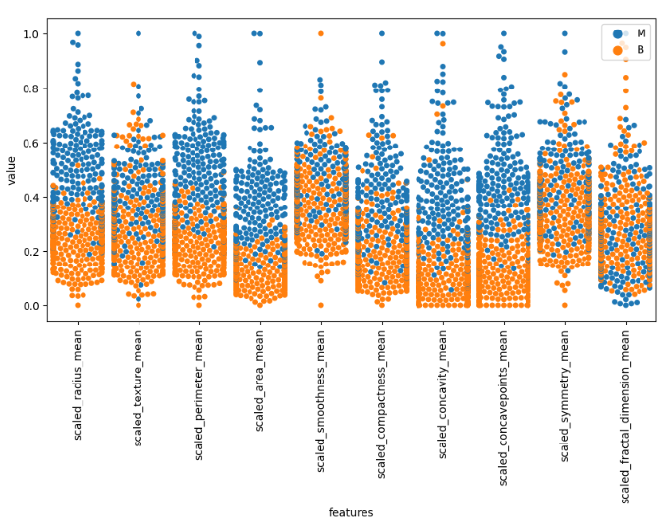
Swarm plot
The Swarm plot gives the idea of the variables usefulness towards identifying the different cancer
Clearly the Fractional Dimensional mean can’t be used

Slide 13
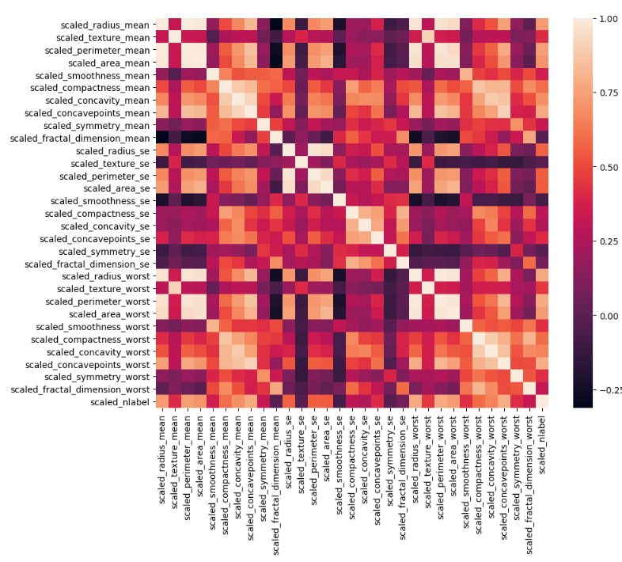
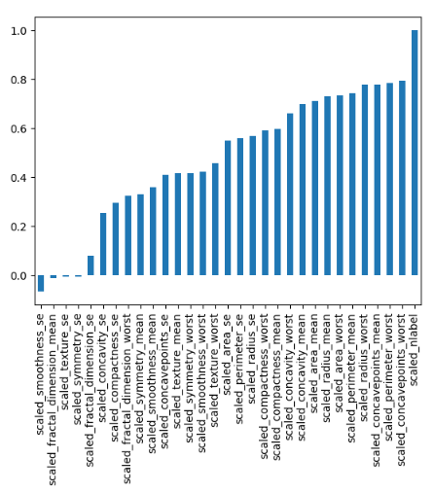
How closely a feature is related to other? To get rid of Multi-collinearity Before Features were fed to ML algorithm, PCA is used here.
Correlation Matrix

Slide 14
Why F1 Score was my choice of metrics?
Accuracy (True Positives and True negatives are more important )
F1-score (False Negatives and False Positives)
In the Health sector, We don’t want Ebola/corona/cancer patient to be classified as Negative!
Since there is imbalanced class distribution, F1 score is better metrics.

Slide 15
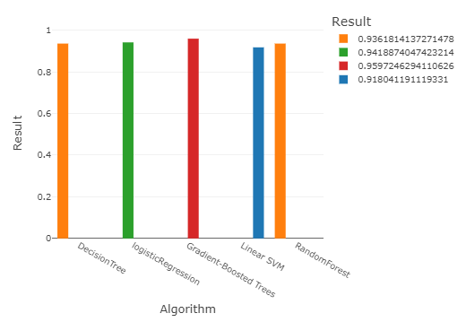
Results of Classification Algorithm
After Grid Search over different parameters

Slide 16
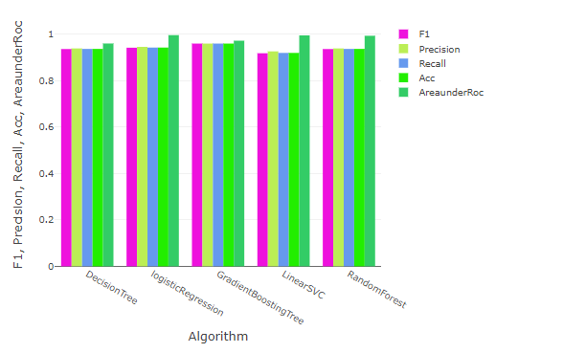
Conclusion:
Gradient Boosted Tree over performed (95.97%)
But with only a sample of 569 dataset, coming to conclusion of algorithms efficiency with respect to F1 score is skeptical
Tryout with Deep Neural Network is a Great Choice to check Classification performance

